Slide 1
Lecture 2: Programming paradigms
Lesson objectives
By the end of this lesson, you will be able to:
Explain the necessity of knowledge about programming paradigms.
Discuss various programming paradigms.
Select a programming paradigm for a given programming task.
Notes:
Procedural programming, structured programming – specifies the steps a program must take to reach a desired state.
Logic programming – defines program logic, but not detailed control flow. This paradigm views computation as automated reasoning over a body of knowledge.
Functional programming – treats programs as evaluating mathematical functions and avoids state and mutable data.
- avoid use of control structures
- use of anonymous functions
Object-oriented programming (OOP) – organizes programs as objects: data structures consisting of data fields and methods together with their interactions.
Event-driven programming – program control flow is determined by events, such as sensor inputs or user actions (mouse clicks, key presses) or messages from other programs or threads.

Slide 2
Programming paradigms
Refer to the way the programming ideas are structured:
Procedural programming(structured programming) – Specifies the steps a program must take to reach a desired state. Ordered sequences of actions.
Advantages
Easy to understand and follow.
Works well for small and simple tasks.
Disadvantages
Hard to manage as programs grow large.
Code reuse is limited.
Applications
Following a cooking recipe.
Filing TAX returns
ATM cash withdrawal steps.
Language: Basic, C
Notes:
Procedural programming, structured programming – specifies the steps a program must take to reach a desired state.
Logic programming – defines program logic, but not detailed control flow. This paradigm views computation as automated reasoning over a body of knowledge.
Functional programming – treats programs as evaluating mathematical functions and avoids state and mutable data.
- avoid use of control structures
- use of anonymous functions
Object-oriented programming (OOP) – organizes programs as objects: data structures consisting of data fields and methods together with their interactions.
Event-driven programming – program control flow is determined by events, such as sensor inputs or user actions (mouse clicks, key presses) or messages from other programs or threads.

Slide 3
Programming paradigms
Refer to the way the programming ideas are structured:
2) Logic programming – Defines program logic, but not detailed control flow. This paradigm views computation as automated reasoning over a body of knowledge. structure programs around rules and logical relationships. Logic programming focuses on stating rules and facts, allowing the computer to reason and reach conclusions.
Advantages
Good for solving complex decision problems.
Less focus on how to solve, more on what is true.
Disadvantages
Can be hard to understand for beginners.
Slower for very large rule sets.
Applications
Legal reasoning systems.
Medical diagnosis support systems.
Languages: Prolog, Python
Notes:
Procedural programming, structured programming – specifies the steps a program must take to reach a desired state.
Logic programming – defines program logic, but not detailed control flow. This paradigm views computation as automated reasoning over a body of knowledge.
Functional programming – treats programs as evaluating mathematical functions and avoids state and mutable data.
- avoid use of control structures
- use of anonymous functions
Object-oriented programming (OOP) – organizes programs as objects: data structures consisting of data fields and methods together with their interactions.
Event-driven programming – program control flow is determined by events, such as sensor inputs or user actions (mouse clicks, key presses) or messages from other programs or threads.

Slide 4
Programming paradigms
Refer to the way the programming ideas are structured:
3) Functional programming – Involves creating programs using expressions and functions without mutating state and data. Function acts as both data and algorithm. Functional programming focuses on using functions that calculate results without changing existing information. Use functions to calculate results, like in mathematics, without changing data.
Advantages
Fewer errors since there is no data changes.
Easy to test and debug.
Disadvantages
Not intuitive for beginners.
Can be inefficient for some tasks.
Real-life applications
Calculating grades or payroll.
Data analysis and transformations.
Language: FORTRAN
Notes:
Procedural programming, structured programming – specifies the steps a program must take to reach a desired state.
Logic programming – defines program logic, but not detailed control flow. This paradigm views computation as automated reasoning over a body of knowledge.
Functional programming – treats programs as evaluating mathematical functions and avoids state and mutable data.
- avoid use of control structures
- use of anonymous functions
Object-oriented programming (OOP) – organizes programs as objects: data structures consisting of data fields and methods together with their interactions.
Event-driven programming – program control flow is determined by events, such as sensor inputs or user actions (mouse clicks, key presses) or messages from other programs or threads.

Slide 5
Programming paradigms
Refer to the way the programming ideas are structured:
4) Object-oriented programming (OOP) – Organizes programs as objects: data structures consisting of data fields and methods together with their interactions. You describe things and what they can do, like people, cars, or bank accounts.
Advantages
Model real-world systems naturally.
Code is reusable and easy to maintain.
Disadvantages
Can be complex to design.
Uses more memory.
Applications
School management systems.
Banking and mobile apps.
Languages: C++, Java, C#
Notes:
Procedural programming, structured programming – specifies the steps a program must take to reach a desired state.
Logic programming – defines program logic, but not detailed control flow. This paradigm views computation as automated reasoning over a body of knowledge.
Functional programming – treats programs as evaluating mathematical functions and avoids state and mutable data.
- avoid use of control structures
- use of anonymous functions
Object-oriented programming (OOP) – organizes programs as objects: data structures consisting of data fields and methods together with their interactions.
Event-driven programming – program control flow is determined by events, such as sensor inputs or user actions (mouse clicks, key presses) or messages from other programs or threads.

Slide 6
Programming paradigms
Refer to the way the programming ideas are structured:
5) Event-driven programming – Program control flow is determined by events, such as sensor inputs or user actions (mouse clicks, key presses) or messages from other programs or threads. The program waits for an event, like a button click, and then responds. EDP structure programs around responses to external or internal events.
EDP focuses on programs that respond when something happens, such as a user clicking a button.
Advantages
Ideal for interactive systems.
Efficient use of system resources.
Disadvantages
Harder to trace program flow.
Debugging can be challenging.
Real-life applications
Mobile apps responding to touches.
Traffic lights reacting to sensors.
Languages: C#, VB.Net
Notes:
Procedural programming, structured programming – specifies the steps a program must take to reach a desired state.
Logic programming – defines program logic, but not detailed control flow. This paradigm views computation as automated reasoning over a body of knowledge.
Functional programming – treats programs as evaluating mathematical functions and avoids state and mutable data.
- avoid use of control structures
- use of anonymous functions
Object-oriented programming (OOP) – organizes programs as objects: data structures consisting of data fields and methods together with their interactions.
Event-driven programming – program control flow is determined by events, such as sensor inputs or user actions (mouse clicks, key presses) or messages from other programs or threads.

Slide 7
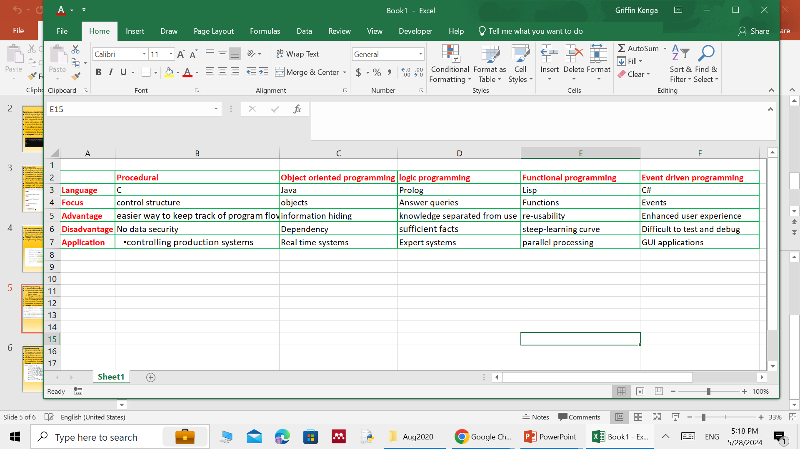
Programming paradigms
Refer to the way the programming ideas are structured:
A comparison matric for programming paradigms
Conclusion
Programming paradigms are different styles of writing programs.
A program can be written as steps, rules, functions, objects, or event responses, and programmers choose the style that best suits the problem they are solving.
Notes:
Procedural programming, structured programming – specifies the steps a program must take to reach a desired state.
Logic programming – defines program logic, but not detailed control flow. This paradigm views computation as automated reasoning over a body of knowledge.
Functional programming – treats programs as evaluating mathematical functions and avoids state and mutable data.
- avoid use of control structures
- use of anonymous functions
Object-oriented programming (OOP) – organizes programs as objects: data structures consisting of data fields and methods together with their interactions.
Event-driven programming – program control flow is determined by events, such as sensor inputs or user actions (mouse clicks, key presses) or messages from other programs or threads.

Slide 8
Programming paradigms
Activity 1:
Construct a comparison matrix for procedural, logic, object oriented and functional programming paradigms based on the following metrics:
Focus
Two advantages
Two draw backs
Two major applications
Notes:
Procedural programming, structured programming – specifies the steps a program must take to reach a desired state.
Logic programming – defines program logic, but not detailed control flow. This paradigm views computation as automated reasoning over a body of knowledge.
Functional programming – treats programs as evaluating mathematical functions and avoids state and mutable data.
- avoid use of control structures
- use of anonymous functions
Object-oriented programming (OOP) – organizes programs as objects: data structures consisting of data fields and methods together with their interactions.
Event-driven programming – program control flow is determined by events, such as sensor inputs or user actions (mouse clicks, key presses) or messages from other programs or threads.

Slide 9
Programming paradigms
Activity 2: Access control system in a Computer Lab
In this task you are given the problem for managing entry into a university computer lab. Each group must
Explain how their program works without naming the paradigm and justify why their approach fits the constraint
Group A: Lab assistant is new and must follow fixed steps.
Group B: Access depends on rules (time, ID validity, course enrolled).
Group C: Entry decision must always be predictable and repeatable.
Group D: System must represent people, rooms, and permissions.
Group E: Doors open only when something happens.
Notes:
Procedural programming, structured programming – specifies the steps a program must take to reach a desired state.
Logic programming – defines program logic, but not detailed control flow. This paradigm views computation as automated reasoning over a body of knowledge.
Functional programming – treats programs as evaluating mathematical functions and avoids state and mutable data.
- avoid use of control structures
- use of anonymous functions
Object-oriented programming (OOP) – organizes programs as objects: data structures consisting of data fields and methods together with their interactions.
Event-driven programming – program control flow is determined by events, such as sensor inputs or user actions (mouse clicks, key presses) or messages from other programs or threads.

Slide 10
Programming paradigms
Activity 3: Relate scenario to a programming paradigm.
In your group describe the thinking style being used. Give a real-life example from your environment. Then at the end name the paradigm.
Group A: “The outcome must be the same every time the same details are provided.”
Group B: “Nothing happens until someone taps an access card.”
Group C: “The decision depends on whether three conditions are all true.”
Group D: “This system keeps records and allows actions on them.”
Group E: “The task must be completed in a strict order.”
Notes:
Procedural programming, structured programming – specifies the steps a program must take to reach a desired state.
Logic programming – defines program logic, but not detailed control flow. This paradigm views computation as automated reasoning over a body of knowledge.
Functional programming – treats programs as evaluating mathematical functions and avoids state and mutable data.
- avoid use of control structures
- use of anonymous functions
Object-oriented programming (OOP) – organizes programs as objects: data structures consisting of data fields and methods together with their interactions.
Event-driven programming – program control flow is determined by events, such as sensor inputs or user actions (mouse clicks, key presses) or messages from other programs or threads.

Slide 11
Programming paradigms
Exercise:
Differentiate between programming convention and programming paradigm.
Describe any two advantages of procedural programming language.
Differentiate between imperative and declarative programming paradigms.
Notes:
Procedural programming, structured programming – specifies the steps a program must take to reach a desired state.
Logic programming – defines program logic, but not detailed control flow. This paradigm views computation as automated reasoning over a body of knowledge.
Functional programming – treats programs as evaluating mathematical functions and avoids state and mutable data.
- avoid use of control structures
- use of anonymous functions
Object-oriented programming (OOP) – organizes programs as objects: data structures consisting of data fields and methods together with their interactions.
Event-driven programming – program control flow is determined by events, such as sensor inputs or user actions (mouse clicks, key presses) or messages from other programs or threads.

Slide 12
Reference:
An introduction to programming by Wu Thomas, Norman and Theodore: McGrill (1997).
C programming language by Brian W. Kernighan, Dennis Ritchie, 2nd ed: prentice hall(2003).
C how to program by H.M. Deitel and P.J.Deitel, 3rd ed: Prentice hall(2001).
https://www.w3schools.in/c-tutorial/
https://www.tutorialspoint.com/cprogramming/index.htm
https://www.learn-c.org/
https://www.studysmarter.co.uk/explanations/computer-science/computer-programming/c-main/

Slide 13
THANK YOU

